Slide 1
Sharing households
Interviewer (sender) >> Bluetooth >> Interviewer (receiver)

Slide 2
Fieldwork Flow
Arrive in cluster, Identify households
Biomarker specialists conduct interviews, HH interviewer enter biomarker data
Supervisor assigns households to interviewers
Interviewers send data to supervisor
Interviewers interview HHs, identify eligible individuals
Team resolves structural problems
Supervisor submits data to central office
Interviewers carry out individual interviews

Slide 3
Reasons for household sharing
Where household interviewer is different gender to some eligible individuals
Male interviewer did household questionnaire, will share household with a female interviewer so she can interview eligible women
female interviewer did household questionnaire, will share household with a male interviewer so she can interview eligible women
Where household has many eligible individuals (men or women) and it is more efficient to divide up interviews among interviewers to ensure interviews are completed in a timely manner

Slide 4
Steps in sharing households
1. The supervisor and household interviewer identify the individuals (men or women) who need to be interviewed by other interviewer(s).
2. Other interviewer(s) prepare to receive data from interviewer of household.
3. Household interviewer sends data, other interviewer confirms.
4. Interviewers locate individuals and begin individual interviews

Slide 5

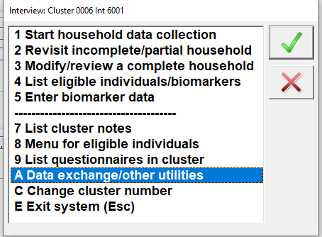
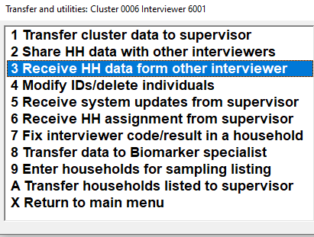
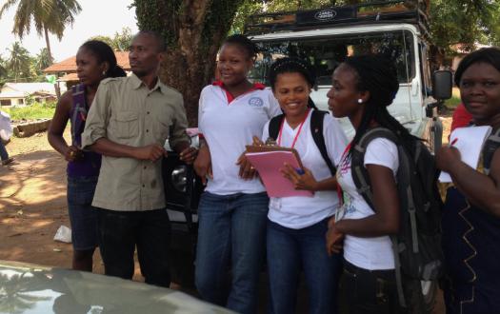
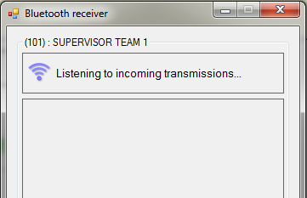
Teammates prepares to receive data
All needing household information prepare to receive…
Notes:
In order to pair over Bluetooth, all who need household information should be listening
Don’t need to go one at a time because same file is being sent to different people

Slide 6

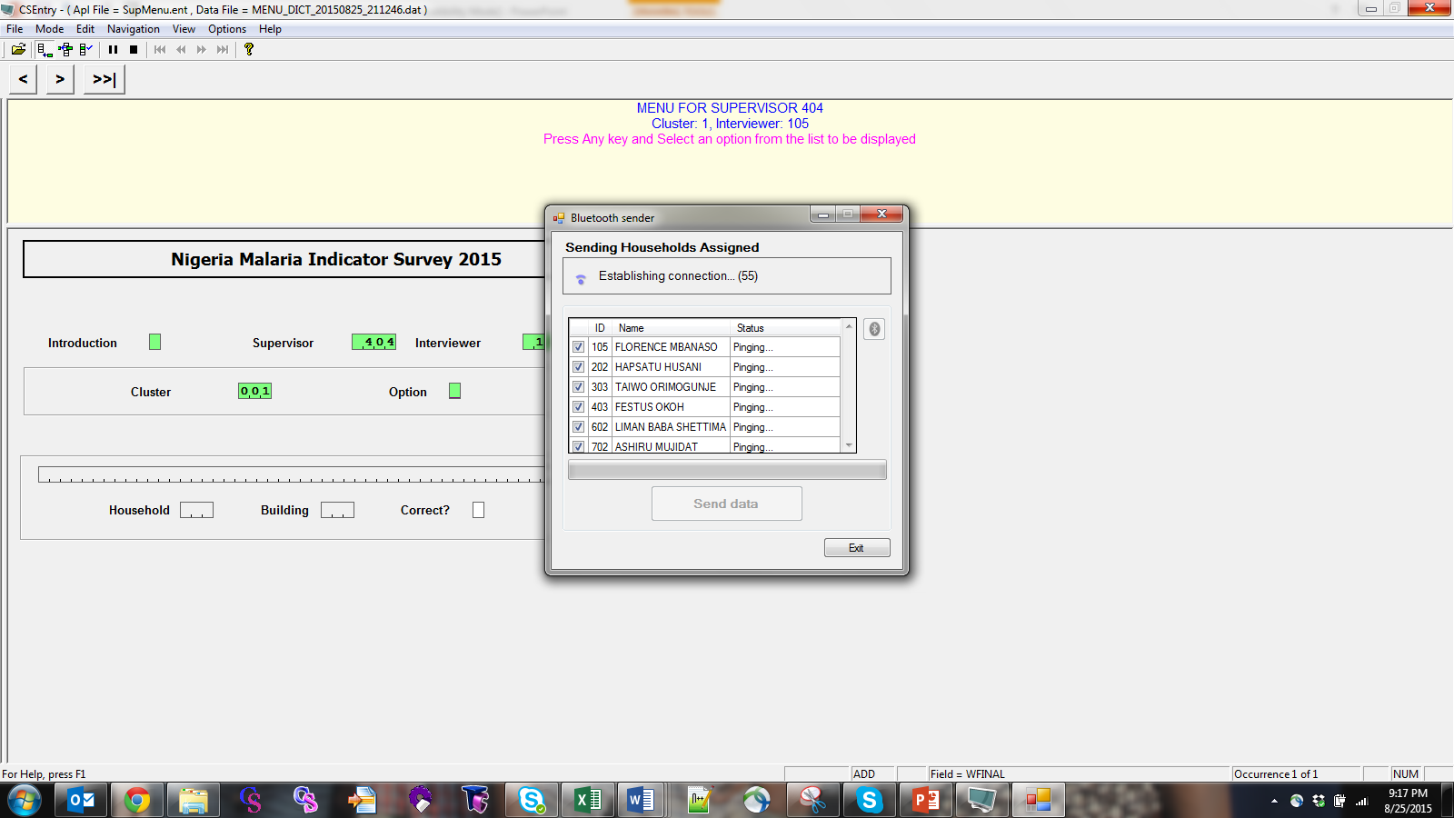
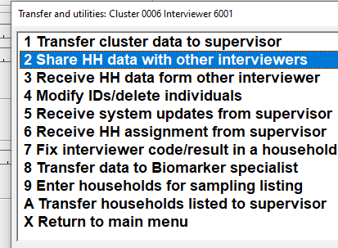
HH Interviewer sends data
Once green, click Send data
If all red, connection failed…
now what??
Notes:
If failed, ASK trainees to tell you what to do if Bluetooth fails… in supervisor manual
1. Check entered supervisor, interviewer, cluster correct in menu 2. try again 3. check Bluetooth is turned on

Slide 7
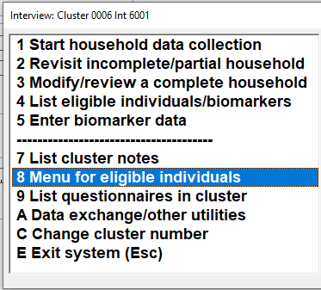
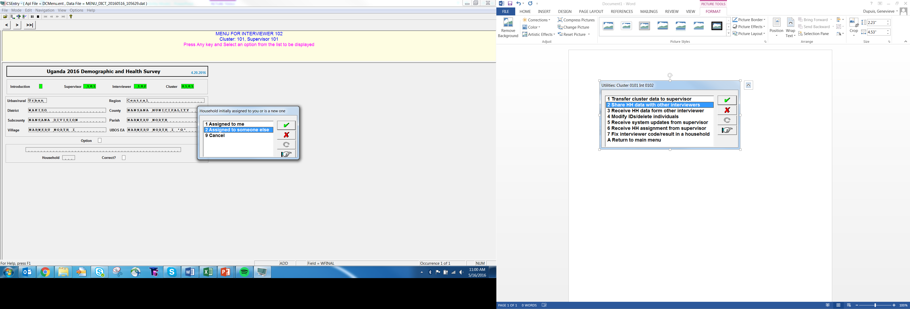

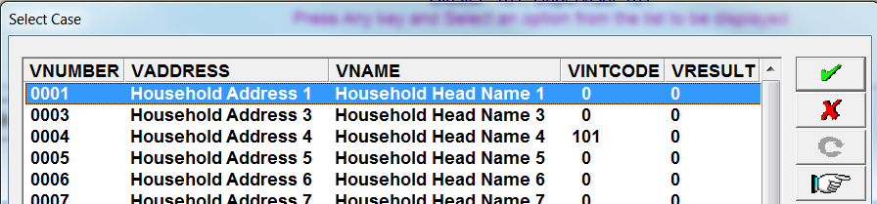
Teammates confirm
If data transfer successful, teammates can see all interviews available to them (individual only!):
Must have written down household number!
Choose correct house and be sure no duplication of work…
Notes:
If correctly transferred, will be able to open up work
Work from teammates doesn’t get mixed in with your own work, don’t worry

Slide 8

Key points about shared households
When an interviewer receives a shared household they can only access eligible individuals from that household via option 8 Menu for eligible individuals
The actual household interview is not accessible by the interviewer receiving the share.
If, during the individual interview, the need arises to correct information collected during the household interview, the correction must be done by the interviewer who did the original household interview, on their tablet

Slide 9
Key points about shared households
When sending data back to the supervisor
individuals from shared households are sent by each interviewer directly to supervisor
All individual interviews for the household will be aggregated on the supervisor tablet
Supervisor can see the entire household with all the eligible individuals interviewed by running option 6: Close/list cluster

Slide 10
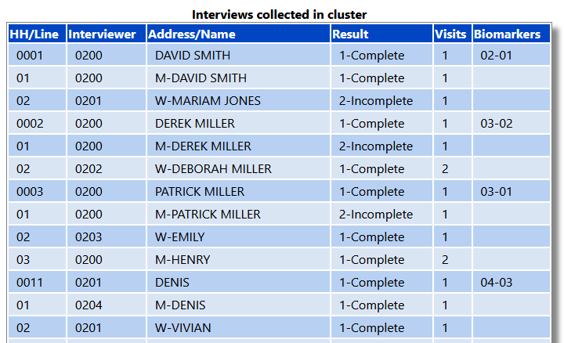
Example report from supervisor menu showing individual interviews from shared households
Exercise
Which households are shared ? How can you tell if they are shared ?
What is the gender of the interviewer who completed the household questionnaire for household number 11 ?

Slide 11
Avoiding Duplicate Cases when sharing households
Once a household is shared the receiving interviewer has access to:
All eligible individuals in that household
All eligible individuals in any other completed household interviews done by the sharing interviewer
Possibility of creating duplicate cases by mistake is very real
To avoid creating duplicate cases:
Be sure to only open individual interviews in the correct household
Pay attention to prompts when starting individual interview to ensure correct person is chosen
Co-ordinate with the interviewer responsible for the household interview and write down the individuals you have been assigned
If you start an interview for the wrong person, quit the interview and use “Discard” option to avoid saving and creating a duplicate

Slide 12
Good practices to minimize the chances of duplicated cases
Interviewers receiving shared household for individual interviews MUST write down:
1. Household number, name, address
2. Individual line number, name of each individual they are to interview
3. Household interviewer’s code

Slide 13
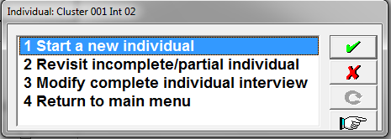
Choose individual to interview
CAREFULLY select correct individual:
Is the person a:
New individual? (1)
Individual started, but not completed? (2)
OR a call-back? (2)
Complete individual to modify? (3)
BE CAREFUL!
Notes:
ASK: Why might a woman you want to interview not be shown?
Answer: You might have picked the wrong household where she lives (or wrong cluster even!); she might not be eligible

Slide 14
How to BE CAREFUL!
Write down
1. Household number, name, address
2. Individual line number, name
3. Household interviewer’s ID
Verify what you wrote down
1. Household number, name, address
2. Individual line number, name
3. Household interviewer’s ID
Pick up the right woman in CAPI system
1. Household number, name, address
2. Individual line number, name
3. Household interviewer’s ID

